Slide 1

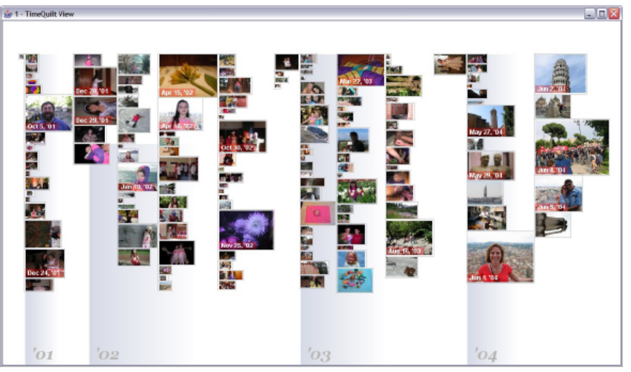
Time Quilt:
Scaling up Zoomable Photo Browsers for Large, Unstructured Photo Collections
David Huynh (MIT CSAIL)
Steven M. Drucker (MSR)
Patrick Baudisch (MSR)
Curtis Wong (MSR)

Slide 2
Why yet another Photo Browser?
Ever increasing sizes for collections of digital photos
With all the effort to annotate, very little traction in use for effective annotation of collections (modulo community annotation)
Still great desire for better overviews

Slide 3
Related Work
Bederson: PhotoMesa, UIST 2001 → Zooming UI
Platt et al: PhotoTOC, MSR-TR, 2002 →
Representative Images
Refs: MediaBrowser, Photofinder, FotoFile, PhotoTOC
Naming your photo system paper:
Mesa
Frame
Album
Finder
Ware
Mountain
TOC
Triage
Photo
Media
Data
Foto
Auto
Pix

Slide 4
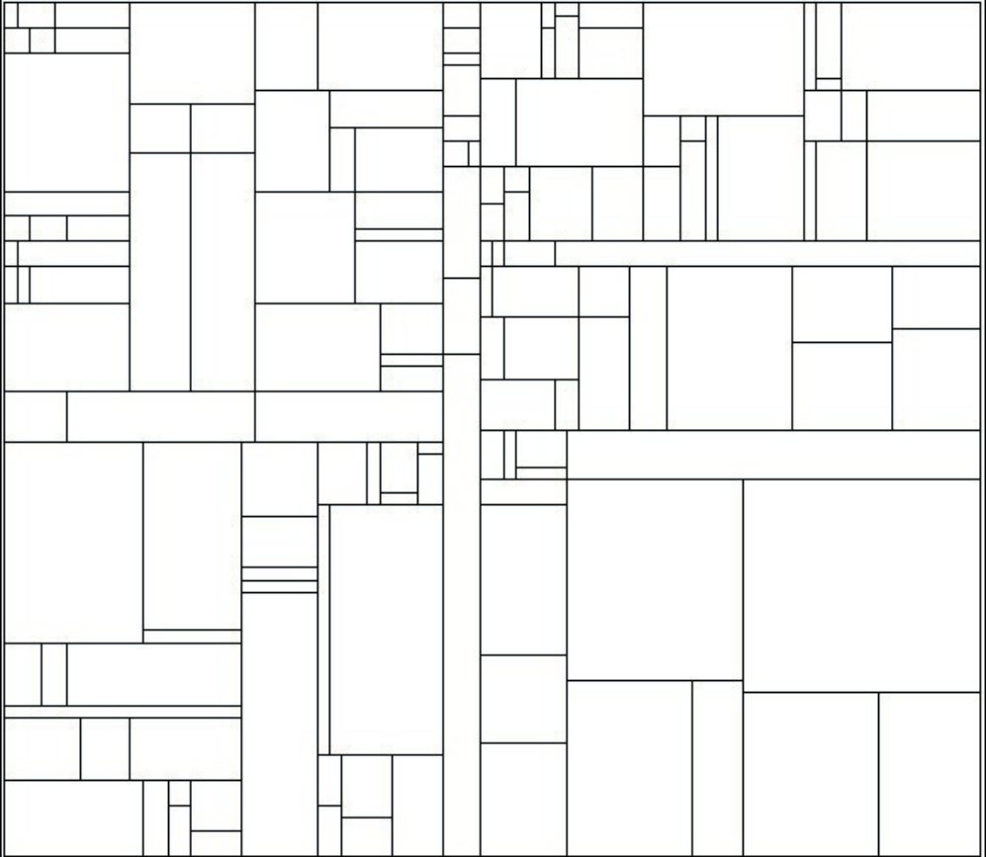
Space-Filling layouts
June 3, 2003
May 8, 2004
May 15, 2004
A space-filling layout of a sample collection of 5,500 photos does not convey chronological order: closer dates might map to far-apart clusters

Slide 5
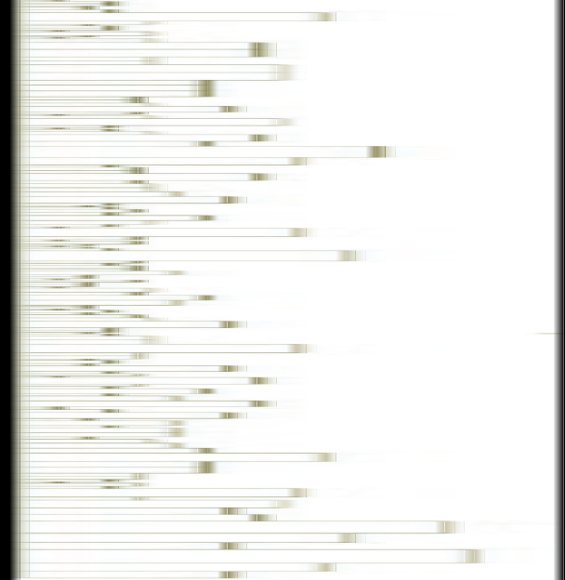
Timeline Layout
Strong representation of time
Poor use of space
No overview

Slide 6
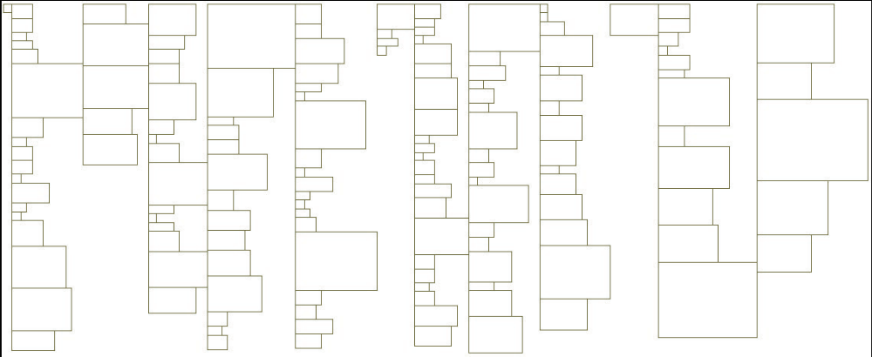
Time Quilt Layout
Weaves a linear timeline into columns
year
boundary
year
boundary
year
boundary

Slide 7
Time Quilt Layout
Rather than space filling, use temporal order
Cluster size based on number of constituent elements
Allows for spatial memory for particular photos
Not necessarily optimal use of white-space, but can create landmarks

Slide 8
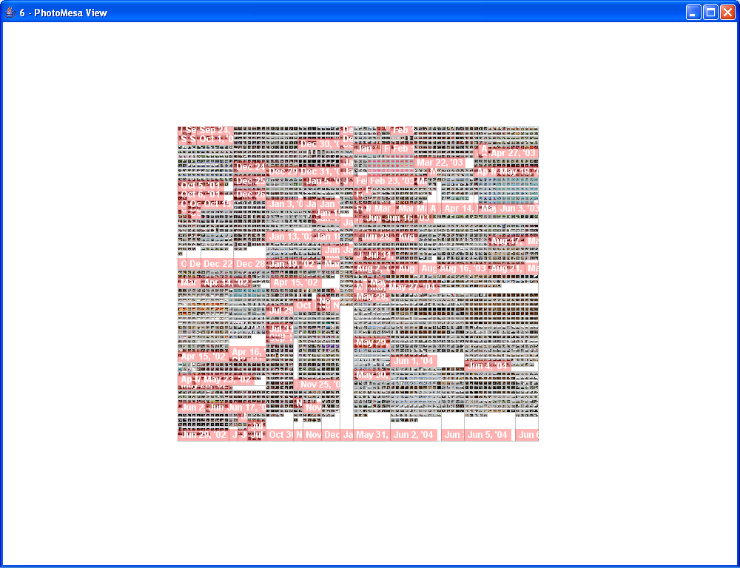
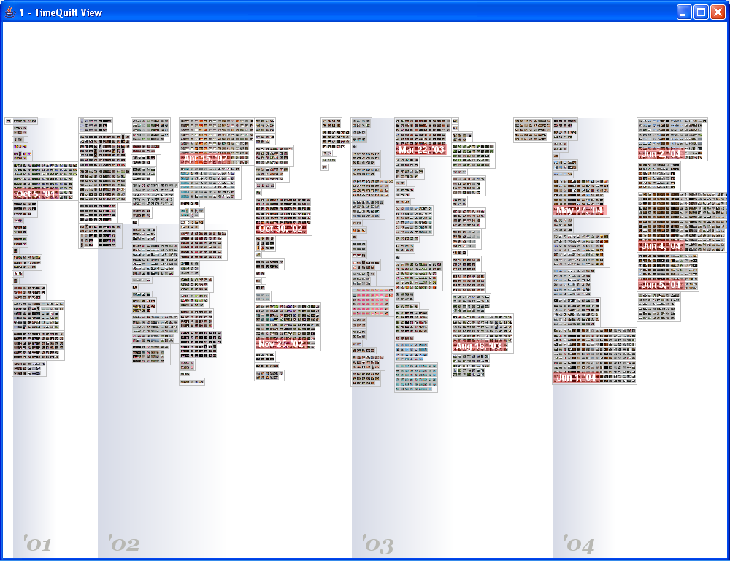
Overviews
Space Filling
Time Quilt

Slide 9
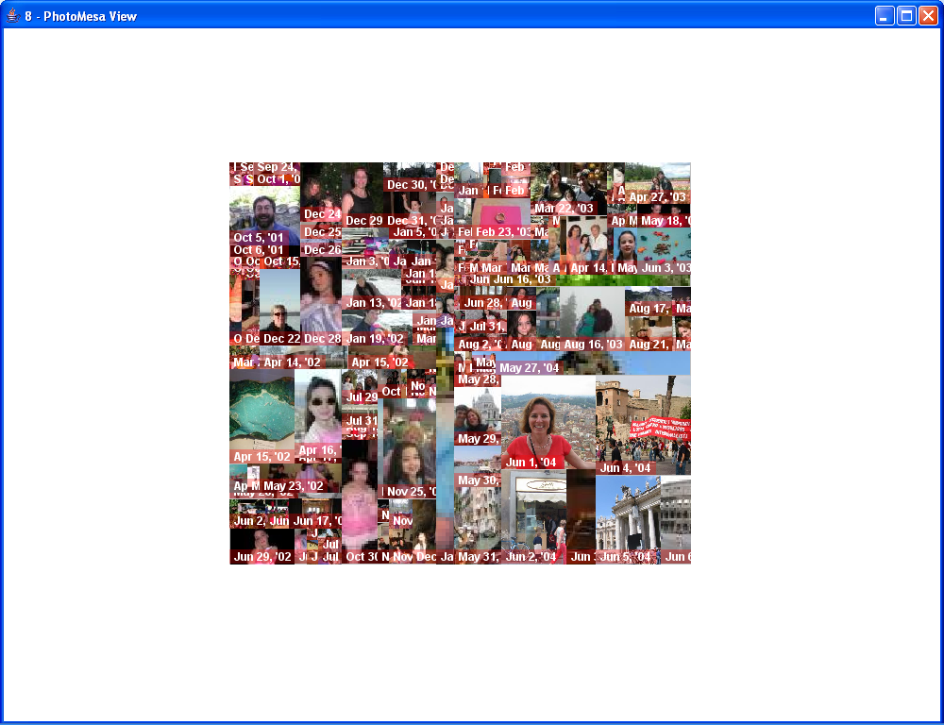
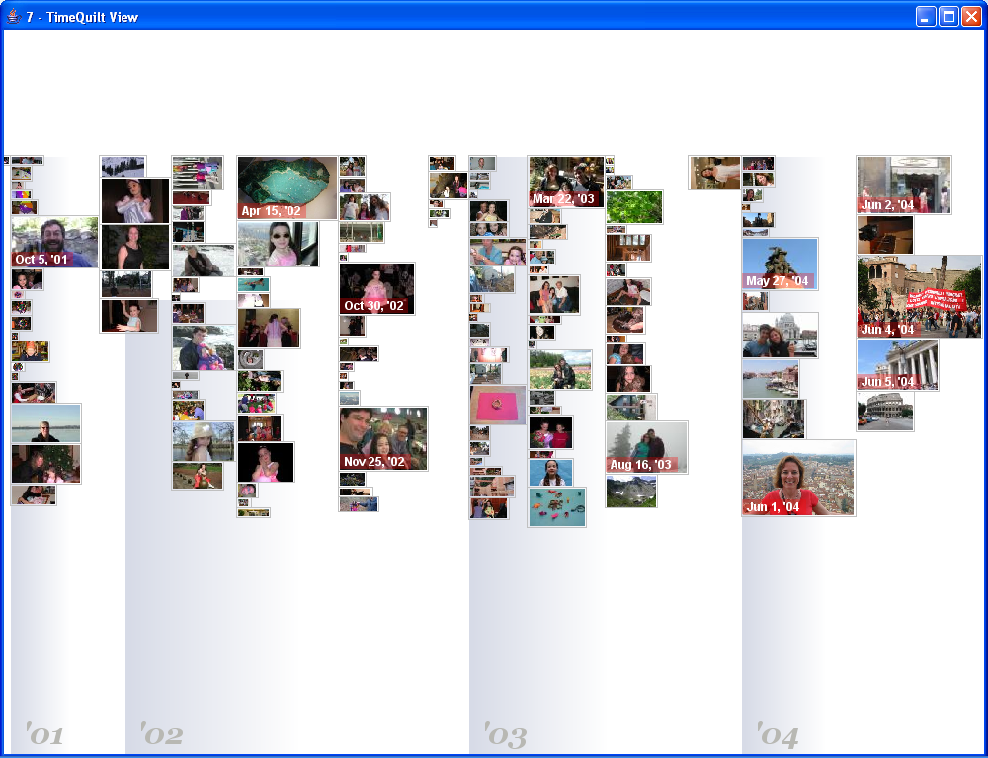
Representative Thumbnails
Space Filling
Time Quilt

Slide 10

Basic Algorithm

Slide 11
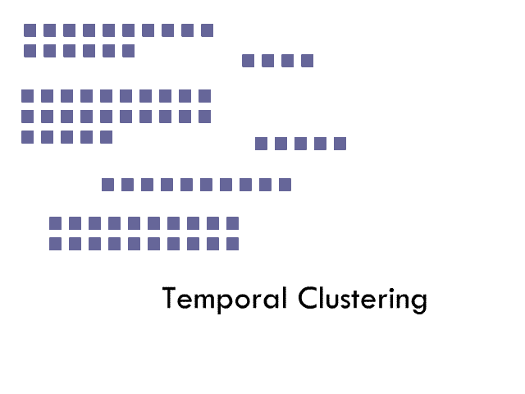
Basic Algorithm

Slide 12
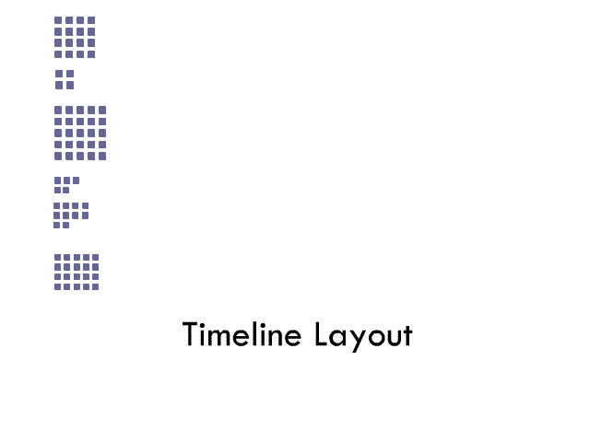
Basic Algorithm

Slide 13

Basic Algorithm

Slide 14
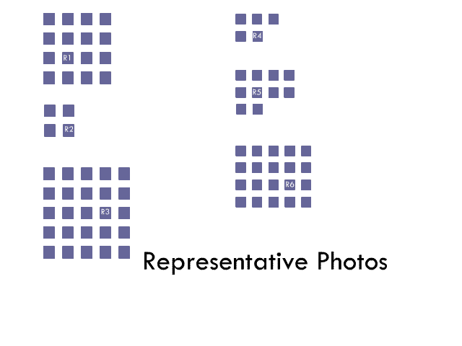
Basic Algorithm

Slide 15
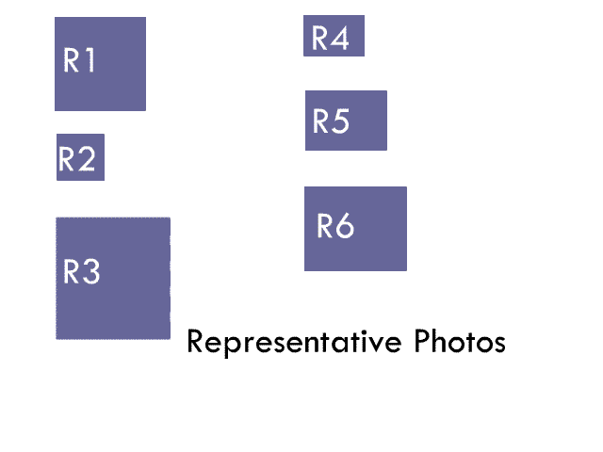
Basic Algorithm

Slide 16
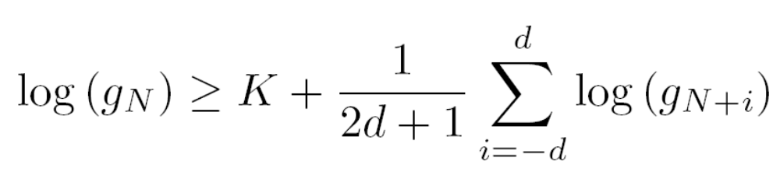
Temporal Clustering
Algorithm from Platt et al …
g_{i} is gap between picture i and picture i+1
d is window size (chosen to be 10 pictures)
K is empirical threshold (chosen to be 17)
Compares a gap to the a local geometric average of gap times, and declares an new event when the difference is large enough.

Slide 17
Representative Photo Selection
We used “dumb algorithm”
  first or middle picture from a cluster
Could do other things:
  See Lim et al. “Content based summarization for personal image library”, Proceedings of the 3rd ACM/IEEE-CS joint conference on digital libraries, 2003.
  Automatic collages

Slide 18
DEMO

Slide 19
Experiment: Retrieving Photos
Within subjects design:
3 different interfaces tried:
  Space filling, timeline and timequilt layouts
Space filling tried with and without representative photos
10 subjects (8 male, 2 female)
Subjects had between 2863 and 5708 photos
Each participant selected 28 favorite photos
Randomly divided selected photos into 4 groups
2 Training photos and 5 photos for actual test

Slide 20
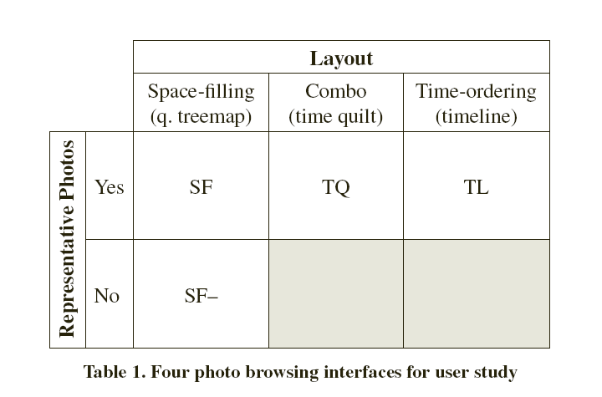
Experiment: Retrieving Photos

Slide 21
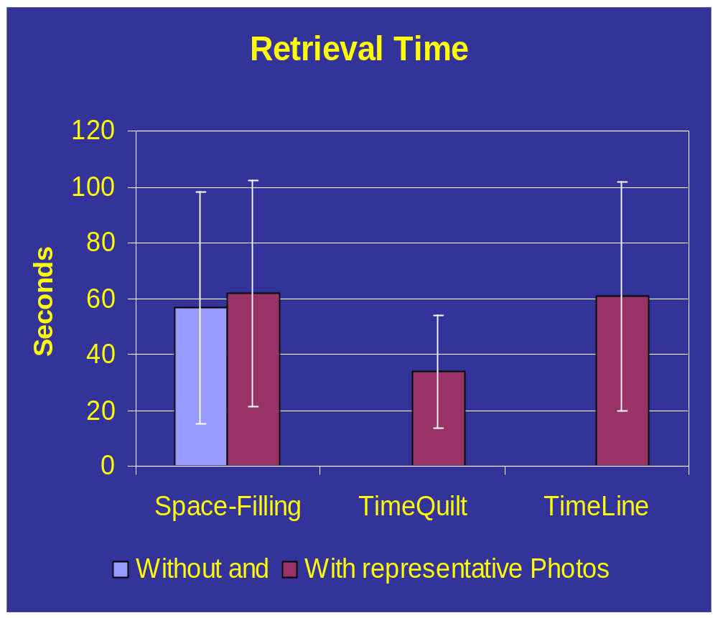
Results

Slide 22
Results
Performed better:
  Better time on TQ than on TL and SF
    (44.2% and 45.1% faster respectively).
    p = 0.002 (F(3,173) = 5.314).
Users like temporally strong layouts:
  Space-filling layouts “Dates are right but locations are completely wrong”
  “Preferred the arrangement of photos by dates and times over the space-filling arrangement”
    (Likert: M = 6.20, SD = 1.476, t-test = .009)

Slide 23
Results: Time based Layout
Strong temporal layout was extremely important to most users though not all
  Sometimes, good pictures were of locations visited over and over again with no strong temporal association.
  Retouched photos lost original date which caused occasional problems to users
  Other date problems (wrong setting on digital timestamp) also caused some difficulties

Slide 24
Results: Representative Photos
Participants liked use of representative photos (contrary to photoTOC work)
The participants also specified that they “preferred the use of representative photos”
  (Likert: M = 5.70, SD = 1.636, t-test = 0.009)
Even though they did not find that “the representative photos were accurate representation of the clusters”
  (Likert: M = 4.30, SD = 1.418, t-test = 0.520).
Their comments also indicated that representative photos were helpful
  “With representative photos, I have more clues of where things are.”
  “There might be a representative picture of that... it’ll get me there much quicker.”
  “Bad key photos are better than nothing.”
  “Bring back my representative photos, please!”
Hierarchical clustering not as useful

Slide 25
Future Work
Better representative thumbnail selection (or creation)
Better navigation (for 12’ experiences, prevent 2D panning issues)
Strategies for dealing with inaccurate dates
Small representative thumbnails
Incorporation of metadata markup and filtering controls

Slide 26
Questions?

